Slide 1
Cataract surgery and diplopia
Auckland 2012
Lionel Kowal
RVEEH

Slide 2
disclaimer
Everything in this talk is distorted by selection bias
I don’t do cataract surgery & don’t see the myriad of happy pts that are produced…I see a small Array of problem pts

Slide 3
Diplopia after cataract surgery
‘Old’ reasons | ‘New’ reasons : Normal or near- normal muscle function: usually ≥1 ‘minor’ stresses on sensory & motor fusion
Inf Rectus contracture after Marcaine damage | Anisometropia: Monovision & Aniseikonia
Other muscles damaged by Marcaine | Metamorphopsia 2ary to macular disease
Incidental 4ths and occult Graves’ Ophthalmopathy uncovered by cataract surgery | Other sensory issues: Big difference in contrast between images, large field defects.
 | Minor acquired motility changes of the elderly: Sagging eye muscles

Slide 4
‘Old’ reasons : Marcaine toxicity
Can be any muscle, usu IR, esp. LIR
Day 1: LIR paresis : left hyper, restricted L depression, diplopia : everyone anxious ≤1%
Day 7-10: diplopia goes : everyone happy
Week 2+: LIR fibrosis begins - diplopia returns : left hypo, restricted L elevation: everyone upset 0.1-0.2%
Hardly ever gets better
Spontaneous recovery from inferior rectus contracture (consecutive hypotropia) following local anesthetic injury.
Sutherland S, Kowal L. RVEEH.
Binocul Vis Strabismus Q. 2003;18(2):99-100.

Slide 5
Seminal article
Persistent Vertical Binocular Diplopia After Cataract Surgery D. A. JOHNSON AM J OPHTHAL 12/2001
5y5m, 7 cataract Drs, 1 strabismus Dr
L >> R eyes X3 (p < .005)
RE injection more ‘natural’ than LE for R-handed injector – see article
Insigniﬁcant (p > 0.2) increase during Hyalase shortage.
1/300 ≈ benchmark
Block: 2.2 ml 2% mepivicaine, 3.8 ml 0.75% bupivicaine,
0.25 ml 1% epinephrine, 150 U hyaluronidase . Σ 6.25 ml
Category | Total number | Diplopia Number | Diplopia %, fraction
All eyes | 17,531 | 32 | 0.18, 1/555
Topical | 3,817 | 0 | 0
Retrobulbar
All | 13,714 | 32 | 0.23%, 1/430
One surgeon own blocks No epinephrine | 7,410 | 0 | 0
Other R/B nurse anesthetists MD anesthetists | 6,304 5989 315 | 32 18 14 | 0.51%, 1/196 0.3%, 1/330 4.4%, 1/23

Slide 6
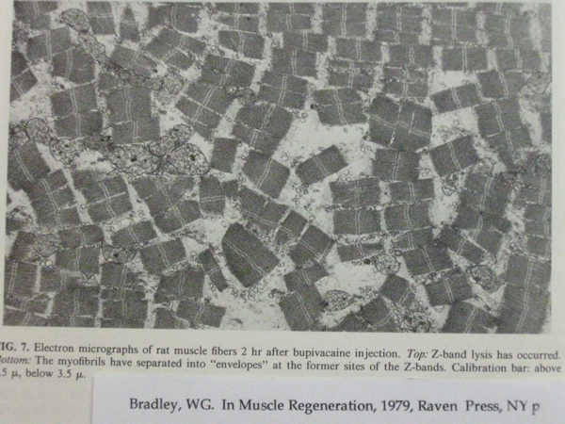
Damage starts <2h From Alan Scott

Slide 7
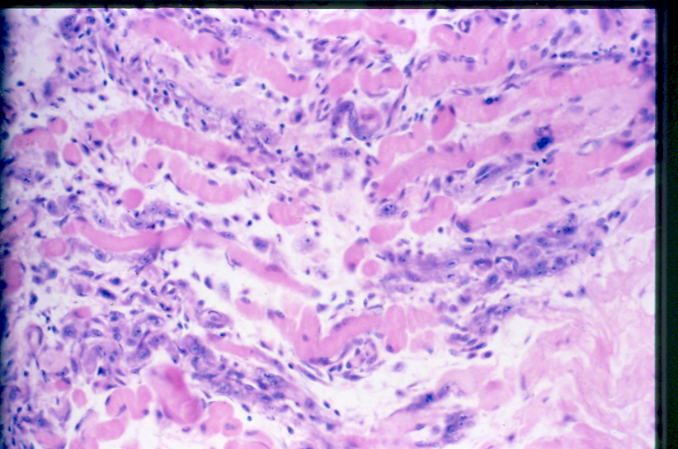
5 days after BP Human [Rainen]
From Alan Scott

Slide 8
Marcaine toxicity
Treatment options
Prisms : Δs often effective (often small angles)
Botox: might work but n=0
Surgery : esp if ≥10Δ
LK: topical, adjust on-the-table, ceiling target for diplopia*, non-absorbable suture
High success rate
* Theatre 2, DSF

Slide 9
Marcaine toxicity
Avoidance
Add EMG monitor to your Retro- or Peri- Bulbar injecting needle: you are often IN the inf rectus
?1/2 the time
avoid R/B & P/B blocks if your problem rate is >1/300

Slide 10
EOM Marcaine toxicity:
New Application: increase the strength of the underacting muscle in strabismus
Injection of Eye Muscles to Treat Strabismus
Alan B Scott, Smith-Kettlewell Institute, San Francisco
e.g. Medial rectus in consecutive XT, Lateral rectus in ET
Off-label use of bupivacaine (BP)
NIH Grant - R01 EY018633
Patent - US # 11/867,532

Slide 11
Diplopia after cataract surgery
‘Old’ reasons | ‘New’ reasons : Normal or near- normal muscle function: usually ≥1 ‘minor’ stresses on sensory & motor fusion
Inf Rectus contracture after Marcaine damage | Anisometropia: Monovision & Aniseikonia
Other muscles damaged by Marcaine | Metamorphopsia 2ary to macular disease
Incidental 4ths and occult Graves’ Ophthalmopathy uncovered by cataract surgery | Other sensory issues: Big contrast differences, large field defects.
 | Minor acquired motility changes of the elderly: Sagging eye muscles

Slide 12
2 very important Qs
1. How much anisometropia is it safe to surgically reduce to try produce glasses independence?
No data
2. How much anisometropia is it safe to surgically introduce in order to give monovision MV?
Some data

Slide 13
Case 1: reducing aniseikona - “sensible” cataract surgery
56 yo Dr for R phaco/IOL
Pre-op refractions (SE)
R -8 D L -2.5 D
Post-op refractions (SE)
R +0.25 D (6/8) L -2.5 D (6/6)
& CONSTANT DIPLOPIA
PCT = XT 8 ∆, LHT 8 ∆
Presumably this was all asymptomatic phoria before cataract surgery

Slide 14
Caught “Knapping”? *
Axial anisometropia doesn’t usu cause aniseikonia
If Axial anisometropia is converted to Lenticular anisometropia, then aniseikonia is to be expected
Aniseikonia impairs motor & sensory fusion and will predispose to diplopia [esp if there is also a (hitherto) trivial motor phoria]
Axial lengths : R 29.48 mm L 26.75 mm
Now has 13% R macropsia
Likely to have been anticipated by pre-op CL testing
Galilean system has resolved diplopia by minimising RE image : + CL [start +1.50, with equivalent - to spectacle lens
Opposite optical arrangement to LE
Trial / error, or use Aniseikonia Inspector ©
*Thank you Logan Mitchell

Slide 15
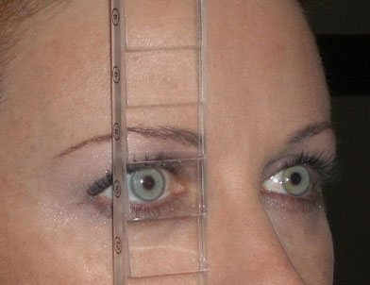
DETECTING & MEASURING ANISEIKONIA 1
Look @ 6/60 E
Which one is bigger? BDΔR, R sees higher image
Does it look like an ‘E’ should? [metamorphopsia]
Is the ‘E’ tilted? [detect torsion]
If a bar of the ‘E’ is worth 20%, how much bigger is it?
Also check with BD
prism in front of other
eye - prisms can also
cause magnification

Slide 16
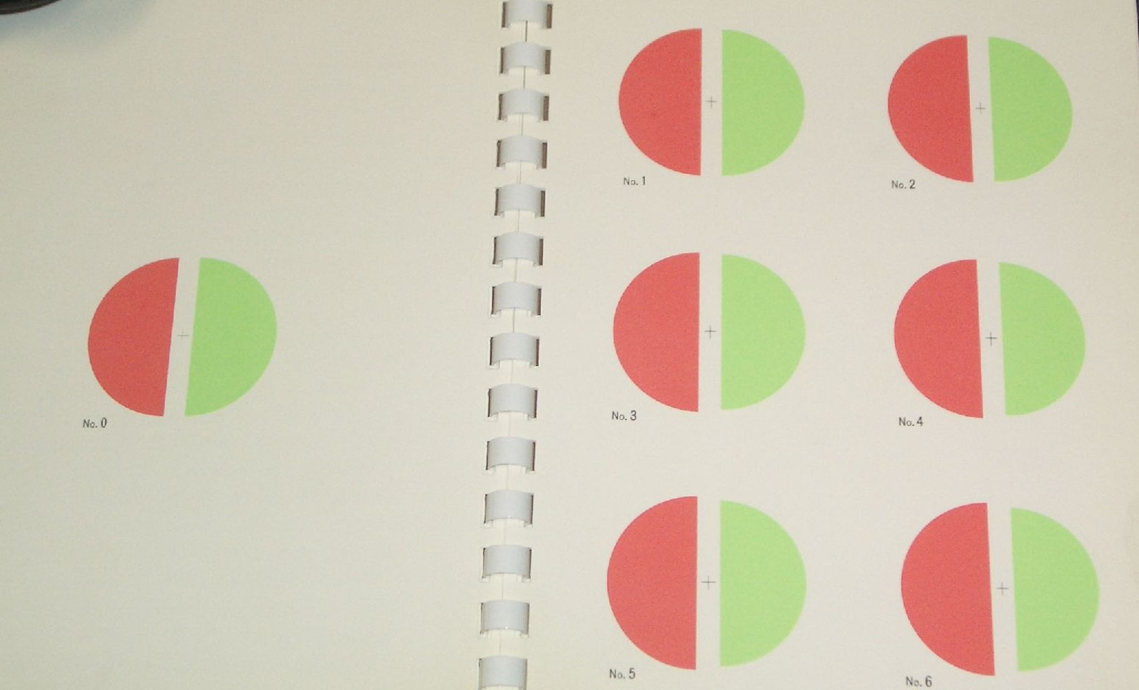
MEASURING ANISEIKONIA 2:
AWAYA’S NEW ANISEIKONIA TEST (NAT)
Use R-G glasses.
Find the pair of semi-circles where the difference in size compensates for the patient’s aniseikonia

Slide 17
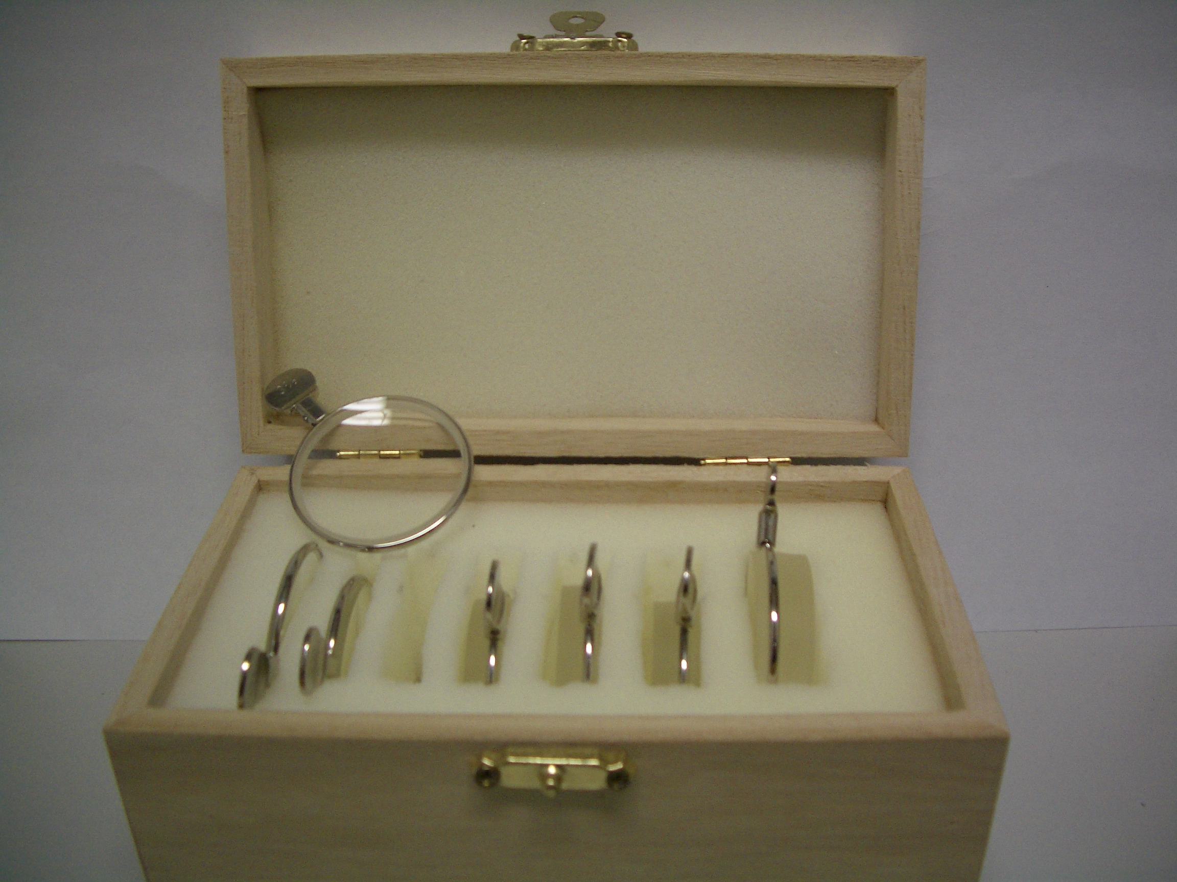
MEASURING ANISEIKONIA 3 most ‘real life’ way:
SIZE LENSES up to ±13%

Slide 18
27 pts
Target refraction for 2nd eye -1 to -1.5
Mean introduced anisometropia 1.16 DS
Ignored all the usual ‘Dominant’ wisdoms
STEREO:
Mean 176”, median 70”, range 40-800. Authors considered this normal.
GLASSES INDEPENDENCE:
Scale 0 [independent, 27% ] to 10 [totally dependent, 4%]
60% 0-2
Mean score 2.7 for near, 1.6 for distance
No orthoptic measurements
No unhappy pts

Slide 19
Amer J Ophthalmol Sept 2010
…success rate for CL-induced MV varies from 50 – 76%
…refractive surgery MV…. patient satisfaction rate ranging from 72-96%
…a significant rate of non- success

Slide 20
Surgical / permanent MV
≠ intermittent / temporary MV 1
3 month MV [early PRK days] : 1/50 pts asymptomatic reduction in fusional reserve
White J. Excimer laser photorefractive keratectomy: the effect on binocular function. In Spiritus M ( Ed): Transactions, 24th Meeting, European Strabismological Association. Buren: Acolus Press, 1997; 252 – 56

Slide 21
Surgical / permanent MV
≠ intermittent / temporary MV 2
118 RS patients. 48 planned MV.
‘Abnormal binocular vision’ (ABV) in 11/48 (22%), ≥1 of
Intermittent / persistent diplopia
Visual confusion
‘Binocular blur requiring occlusion to focus comfortably’.
70 pts did not have MV, 2 had ABV (3%).
Average anisometropia in
13 pts with ABV: 1.90 DS
105 pts with normal BV: 0.50 DS (p<0.001).
Kowal L, De Faber J, Calcutt C, Fawcett S. ‘Refractive surgery and strabismus’ (Workshop in ‘Progress in Strabismology’).
In: de Faber JT, ed. Proceedings of the 9th Meeting of the International Strabismological Association, Sydney, Australia.

Slide 22
Surgical / permanent MV
≠ intermittent / temporary MV 2
3 pts with MV IOLs who developed ET with diplopia ≥2 y after IOLs
Rx: Reverse the MV
Pollard et al Am J Ophthal 2011
This paper also contained examples of CL MV causing delayed diplopia

Slide 23
AAO Preferred Practice Pattern
ASCRS survey (USA)
2003: 86% of surgeons preferred MV, 13% preferred multifocal IOL
2007: MV 61% , multifocal IOL 17.5%.
New Zealand
2004 : MV preferred by 81%.
2007 : MV 50%, multifocal IOL 31%
Though decreasing, MV is still a common surgical approach to spectacle independence

Slide 25
how much anisometropia is it safe to:
1. reduce? 2. introduce ?
1. Evidence based:
Reduce: no evidence
Introduce:
RS cohort: 1.9DS too much; ~20% have ABV
In RS MV cohort, commonest cause for re-Rx is usually DISTANCE correction, not MV-associated issues
BraunEH… Monovision in LASIK. Ophthalmology 2008; 115:1196–1202.
Small IOL cohort: 1.16DS acceptable

Slide 26
how much anisometropia is it safe to:
1. reduce? 2. introduce ?
2. Eminence based: ..introduce / reduce as little as possible.
Anisometropia in RS: ‘mini- MV’ 0.5 to 1.5 DS… others up to 2.75DS
No universally accepted criteria for IOL-MV.
Common: Full distance Rx to dominant eye.
Ocular Dominance: hole- in- card to VEP. Some ‘cross MV’.
? ignore dominance ‘….in most patients, ocular dominance is not ﬁxed but is rather a ﬂuid phenomenon with signiﬁcant higher cortical adaptation’
EvansBJ. Monovision:areview. OphthalmicPhysiolOpt2007;27:417–439.
Every time you reduce or introduce anisometropia ….there is an unknown [?] low % of problem patients, and the % probably increases with time after surgery.

Slide 27
Diplopia after cataract surgery
‘Old’ reasons | ‘New’ reasons : Normal or near- normal muscle function: usually ≥1 ‘minor’ stresses on sensory & motor fusion
Inf Rectus contracture after Marcaine damage | Anisometropia: Monovision & Aniseikonia
Other muscles damaged by Marcaine | Metamorphopsia 2ary to macular disease
Incidental 4ths and occult Graves’ Ophthalmopathy uncovered by cataract surgery | Other sensory issues: Big contrast differences, large field defects.
 | Minor acquired motility changes of the elderly: Sagging eye muscles

Slide 28
Case 2: Small verticals: a newly recognised mechanism for diplopia in the elderly: Saggy eye muscles
82 y o Intermittent Horizontal diplopia, mainly on left gaze, since cataract surgery 4y ago
R 6/9, L 6/6
Horizontal Deviation:
0
0 6ET 12ET
6ET
Small L hypo in primary
Prescribed glasses:
  8Δ BO, 2Δ BU LE ➔ single vision

Slide 29
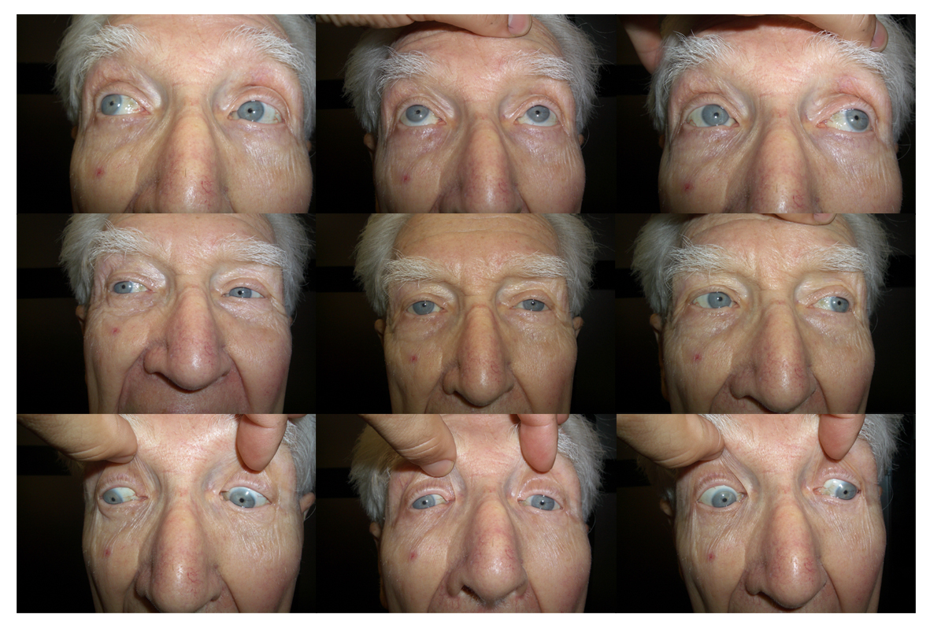
Restricted
depression
on L aBduction

Slide 30
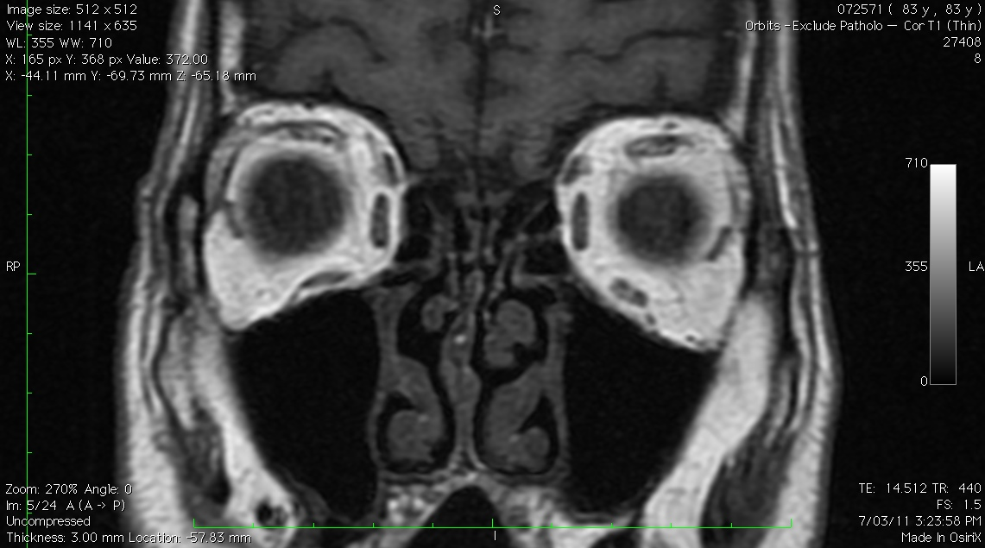
some atrophy of
LSR – LLR tissue sling
‘better’ SR – LR
tissue sling
Sagging of LLR pulley
Not directly related to cataract surgery, but happens in same age group and will be attributed by patients to cataract surgery

Slide 31
LR-SR inter-muscular sling
Degeneration of the LR-SR sling may occur in elderly
Inferior displacement of the LR Pulley.
LR is now a less capable aBductor, & now has an infraduction vector as well
ET & Hypotropia
Demer JL et alii “Heavy Eye” Syndrome in the Absence of High Myopia: A Connective Tissue Degeneration in Elderly Strabismic Patients J AAPOS. 2009 February; 13(1): 36–44.

Slide 32
Diplopia after cataract surgery
‘Old’ reasons | ‘New’ reasons : Normal or near- normal muscle function: usually ≥1 ‘minor’ stresses on sensory & motor fusion
Inf Rectus contracture after Marcaine damage | Anisometropia: Monovision & Aniseikonia
Other muscles damaged by Marcaine | Metamorphopsia 2ary to macular disease
Incidental 4ths and occult Graves’ Ophthalmopathy uncovered by cataract surgery | Other sensory issues: Big contrast differences, large field defects.
 | Minor acquired motility changes of the elderly: Sagging eye muscles

Slide 33
Case 3: Diplopia following "routine" cataract surgery
70 yo F
High myope
H diplopia after 1st cataract surgery
‘It’s because of the imbalance - will be better after 2nd eye is done’

Slide 34
2nd eye cataract surgery 1w later
Diplopia same…2nd image now clearer.
Symptoms dismissed [again] – ’It’ll get better’
2nd ophthalmologist: ..you’re 6/6 OU…looks great … I’m a cataract surgeon….
If you can’t understand a pt’s symptoms, it doesn’t mean they are not there…or not important

Slide 35
Case 3: Hemianopia:
If it’s bad enough to cause loss of fusion = retinal slip, field loss won’t be subtle and will be detectable on confrontation to movement of or counting fingers, losing ½ a vision chart
…large pituitary tumour removed a few weeks later

Slide 36
Diplopia after cataract surgery
‘Old’ reasons | ‘New’ reasons : Normal or near- normal muscle function: usually ≥1 ‘minor’ stresses on sensory & motor fusion
Inf Rectus contracture after Marcaine damage | Anisometropia: Monovision & Aniseikonia
Other muscles damaged by Marcaine | Metamorphopsia 2ary to macular disease
Incidental 4ths and occult Graves’ Ophthalmopathy uncovered by cataract surgery | Other sensory issues: Big contrast differences, large field defects.
 | Minor acquired motility changes of the elderly: Sagging eye muscles

Slide 37
Modern macular treatments preserve acuity but do not prevent metamorphopsia & aniseikonia
Can be occult until vision improving surgery

Slide 38
You don’t have to examine your pts in great detail: Sensory causes nearly ALL diagnosable on history
ASK EVERY PATIENT WITH POST CATARACT DIPLOPIA that is not IR fibrosis:
Is the image seen by the R:
Larger / smaller than the one seen by the L
Same shape as L
Paler / darker than L
Tilted [torsion]
Final Q: Does it wobble? Heiman Bielschowsky, Sup Obl Myokymia, Horor Fusionis, Oculo palatal myoclonus,…
ALL OF THESE ARE BARRIERS TO FUSION

Slide 39
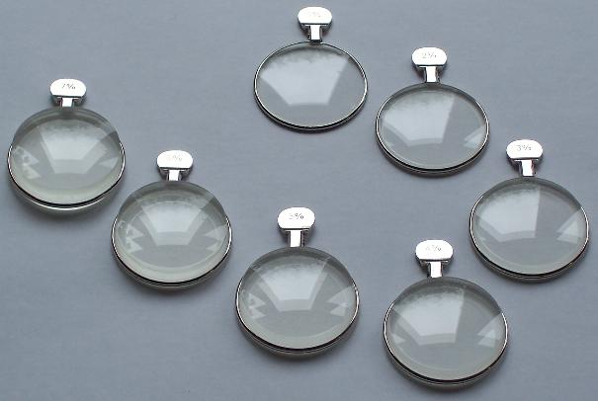
Optical solutions to in- /de- crease image size & resolve diplopia
Increase front base curve
Increase central thickness
Decrease BVD ( - lens)
Increase refractive index
+CL & - spectacle lens to minimise size
‘Thick’ lenses
Special Order
Lenses we prescribe are always ‘thin’ lenses
Prisms
….often successful!

Slide 40
High risk #1: Beware correcting / ‘improving’ anisometropia
Spectacles compensate for most cases of aniseikonia 2° to axial anisometropia BETTER than do IOLs or corneal refractive surgery
Converting R: -12, L: -4 to -2 DS OU runs a real risk of PRODUCING aniseikonia, ABV & permanent troublesome diplopia esp if there is a small hitherto asymptomatic & unrecognised phoria
NO prospective studies to guide us how to handle anisometropic pts having IOLs

Slide 41
High risk #2: Beware of monovision
There are insufficient prospective studies that can tell us which pts are safe for IOL MV
You need to tell MV pts that there is a small risk [?%] of problems that seem to be fixable by reversing the MV.
Sometimes these problems can present 2-3 y after surgery.
CL testing probably <100% predictive

Slide 42
High risk #3 : Beware macular membranes
Metamorphopsia / aniseikonia can be beyond the ability of optical devices to resolve
Cataract surgery can cause permanent diplopia in these pts

Slide 43
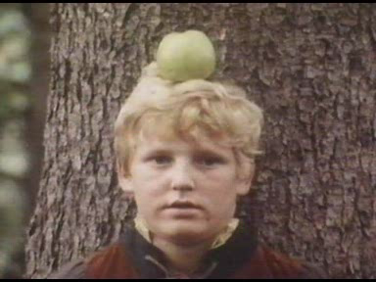
Thank you & good luck
When assessing your results, you need to get the whole picture

Slide 46
EOM Marcaine toxicity:
New Application
Injection of Eye Muscles to Treat Strabismus
Alan B Scott
Smith-Kettlewell Eye Research Institute, San Francisco
Off-label use of bupivacaine (BP)
NIH Grant - R01 EY018633
Patent - US # 11/867,532

Slide 47
Changing Extraocular Muscle (EOM) Biomechanical Properties
Surgery Botox(BT) Bupivacaine(BP)
Size 0 - +
Strength 0 - +
Stiffness 0 - +
Length + + -
Tension + - +
Vector + 0 0

Slide 48
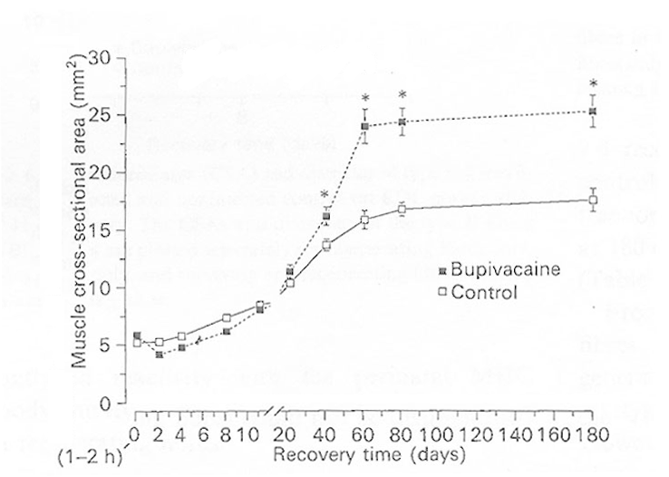
BP injection in animals:
Damage→Regeneration→Hypertrophy
Rosenblatt & Woods, 1992. Rat, ext. digit. long.

Slide 49
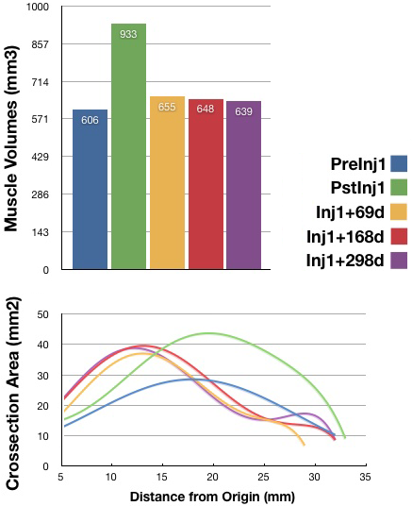
Volumes & Cross-sectional Areas
Pre-Injection, post-Injection,
and follow-up scans track changes
in muscle volume
Crossection analysis shows
location of injection bolus (￭),
and pattern of regrowth (￭, ￭, ￭)

Slide 50
BP Treatment of strabismus:
Probably useful for 10-12Δ horizontal strabismus
?place in ptosis treatment

Slide 51
Diplopia following "routine" cataract surgery
70 yo F
High myope
H diplopia after 1st cataract surgery
‘It’s because of the imbalance - will be better after 2nd eye is done’

Slide 52
2nd eye cataract surgery 1w later
Diplopia same…2nd image now clearer.
Symptoms dismissed [again] – it’ll get better
2nd ophthalmologist: ..you’re 6/6 OU…looks great … I’m a cataract surgeon….
If you ignore a pt’s symptoms, they don’t go way.

Slide 53
Diplopia following "routine" cataract surgery : Motor and sensory causes
Motor cause – in days of blocks, were common in a strabismus practice; now very rare
All types / variations of motor causes usually easily recognised EXCEPT torsional diplopia : you have to ask the pt: is the 2nd image tilted?
If pt doesn’t behave like the typical IR palsy- then- fibrosis : Image
Occult Graves’ an irregular surprise

